Slide 1


TREASURY TALENT:
WHAT DOES THE
FUTURE HOLD?
22nd May 2019

Slide 2
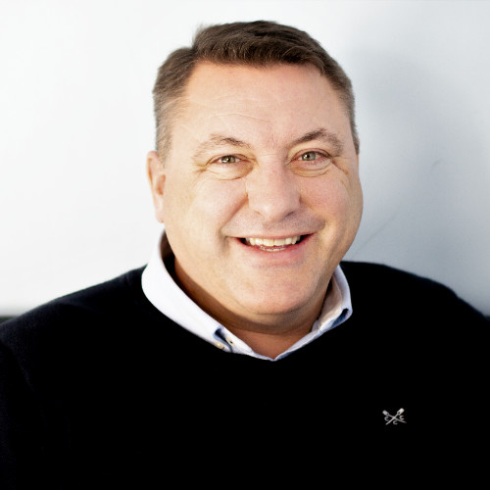
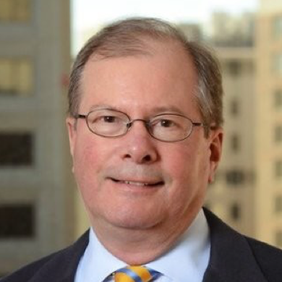
Mike Richards
CEO & Founder
The Treasury Recruitment
Company
Craig Martin
Director, US Practice
The Treasury Recruitment Company

Slide 3
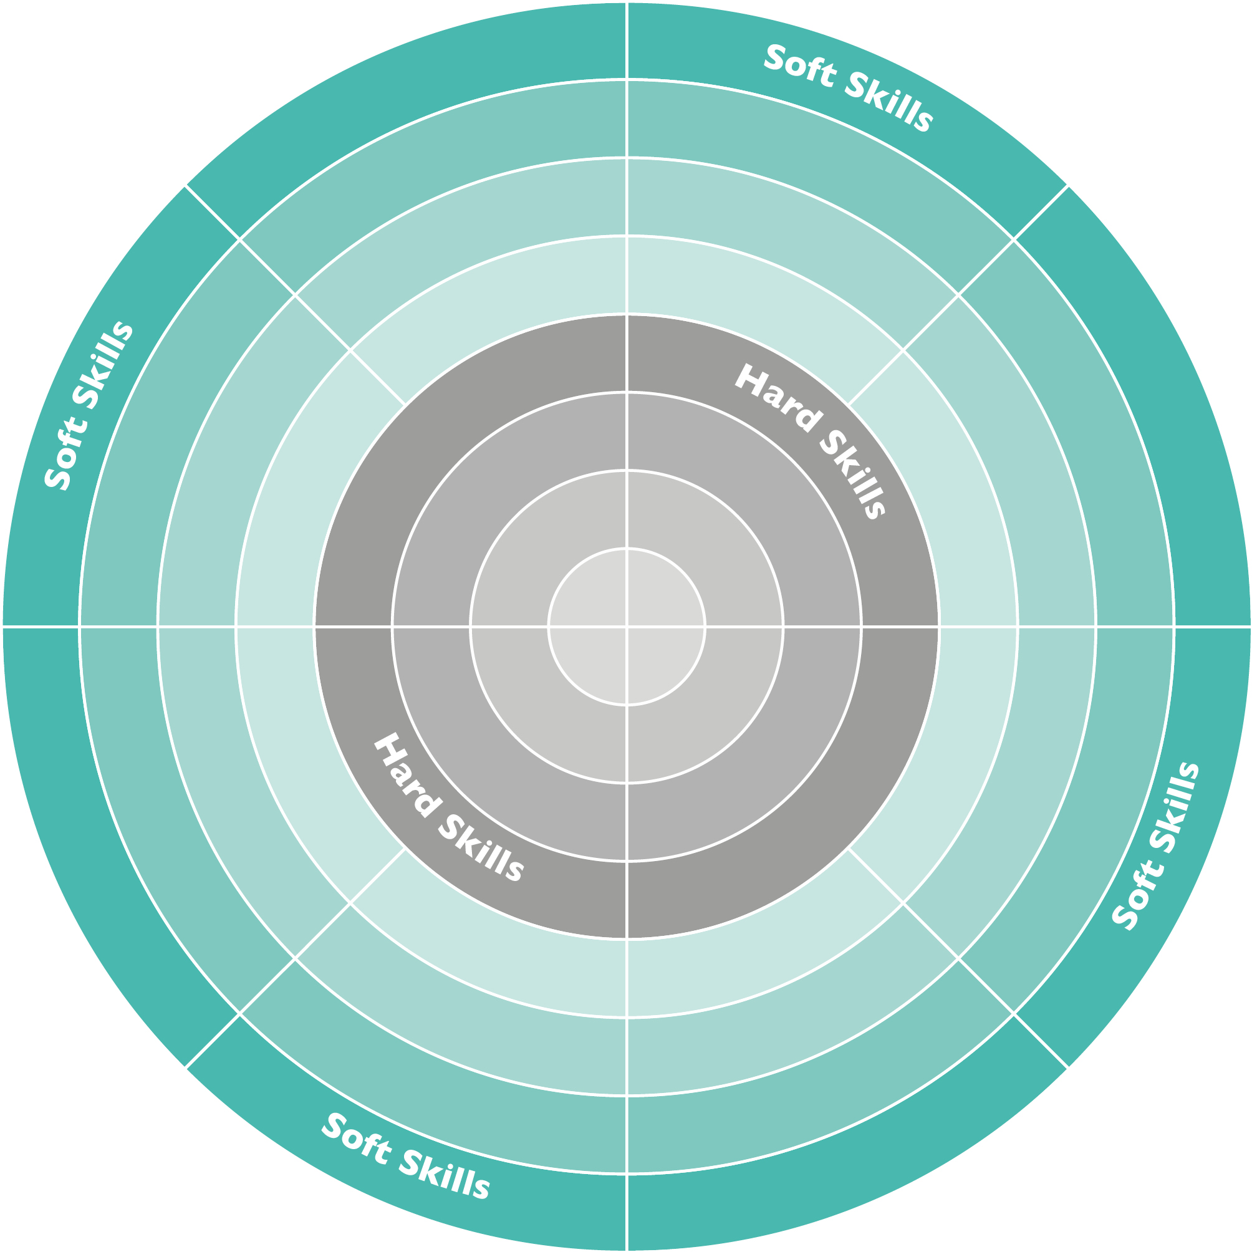
TREASURY
SKILLS
WHEEL
Soft
Skills
Combination
of people skills, personality traits & attributes
Hard Skills
Teachable skills or those that are easy to quantify

Slide 4
WHY USE IT?
PROMOTES SELF-ASSESSMENT
ENCOURAGES MULTI-SKILLING
IMPROVES HIRING DECISIONS
SUPPORTS SKILLS ASSESSMENTS

Slide 5


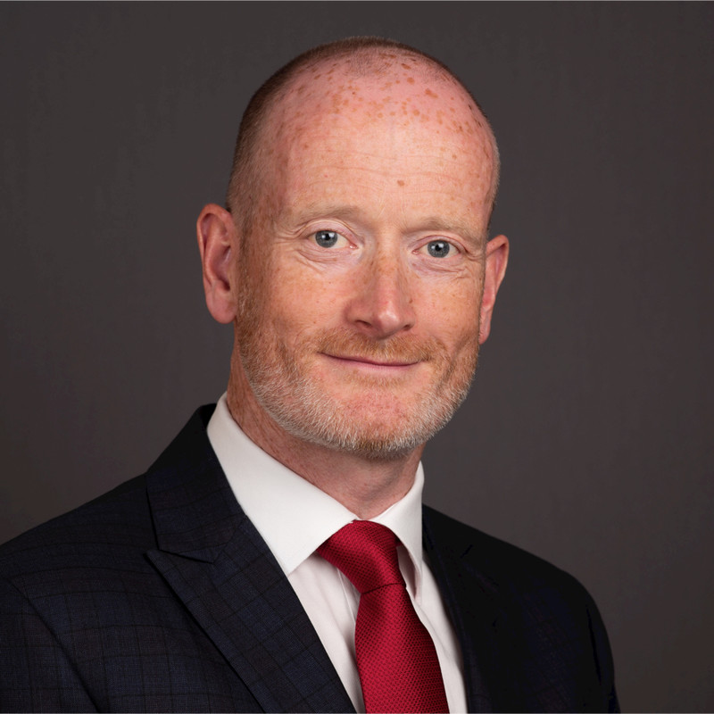
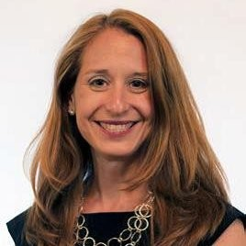
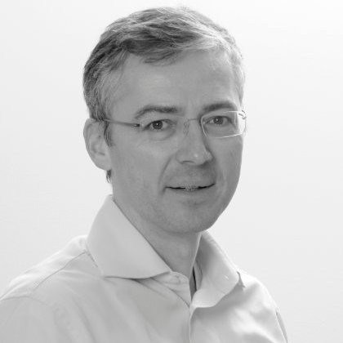
QUALIFICATIONS
“Qualifications have allowed me to be more nimble, able
to jump in and know exactly how to deal with certain situations”
DANA LAIDHOLD, TREASURER, PELOTON
Photo
“Qualifications give
you a much broader perspective and
solid grounding"
OLIVER EISS, GROUP TREASURER,
JOHNSON MATTHEY
“Qualifications have been the one constant throughout my career and the technical experience I have gained has been
forever valuable.”
CONOR MAHER,
HEAD OF CASH
& LIQUIDITY, RBS

Slide 6
NEVER EXCLUDE SOMEONE BECAUSE THEY DON’T HAVE A QUALIFICATION AND DON’T HIRE THEM JUST BECAUSE THEY DO
Conor Maher,
Head of Cash & Liquidity, RBS

Slide 7

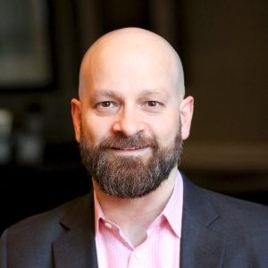
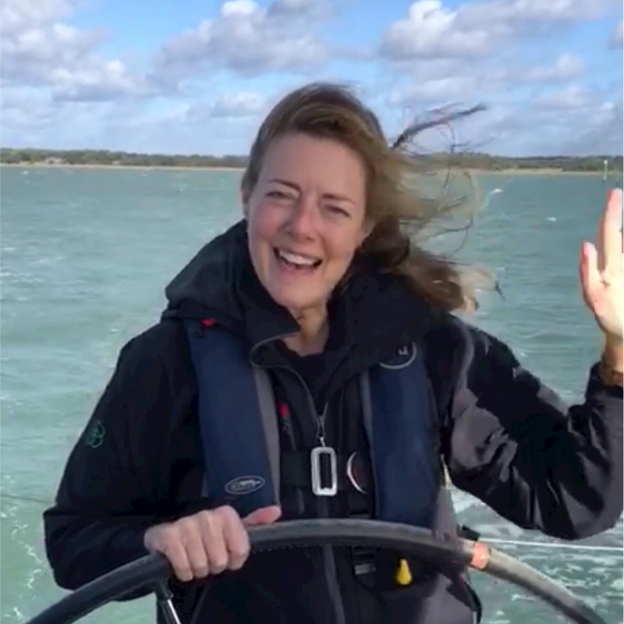
DIVERSE EXPERIENCE
“Need to gain as much exposure to
as many different areas of treasury
as you can”
SARAH-JANE HALL, GROUP TREASURER, GSK
“Getting as broad a career as possible – experiencing different ways of thinking, different types of problems and different types of people”
FRED SHACKNIES, SENIOR VP & TREASURER, HILTON WORLDWIDE

Slide 8
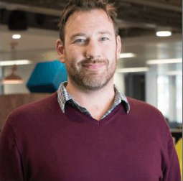
IN A TREASURY TEAM, THE SUM IS MOST DEFINITELY GREATER THAN THE PARTS
Eddie Trahearn,
Director of Treasury, Belmont Green Finance

Slide 9

PROJECT MANAGEMENT
Oliver Eiss,
Group Treasurer, Johnson Matthey
GET AS MUCH PROJECTS AND PROJECT MANAGEMENT EXPERIENCE AS POSSIBLE

Slide 10






BE A
PROBLEM
SOLVER
GET PROJECT CERTIFIED
BE AN EFFECTIVE
TEAM PLAYER
IMPROVE YOUR PROJECT MANAGEMENT SKILLS
EMBRACE
CHANGE
LEARN EMOTIONAL INTELLIGENCE

Slide 11
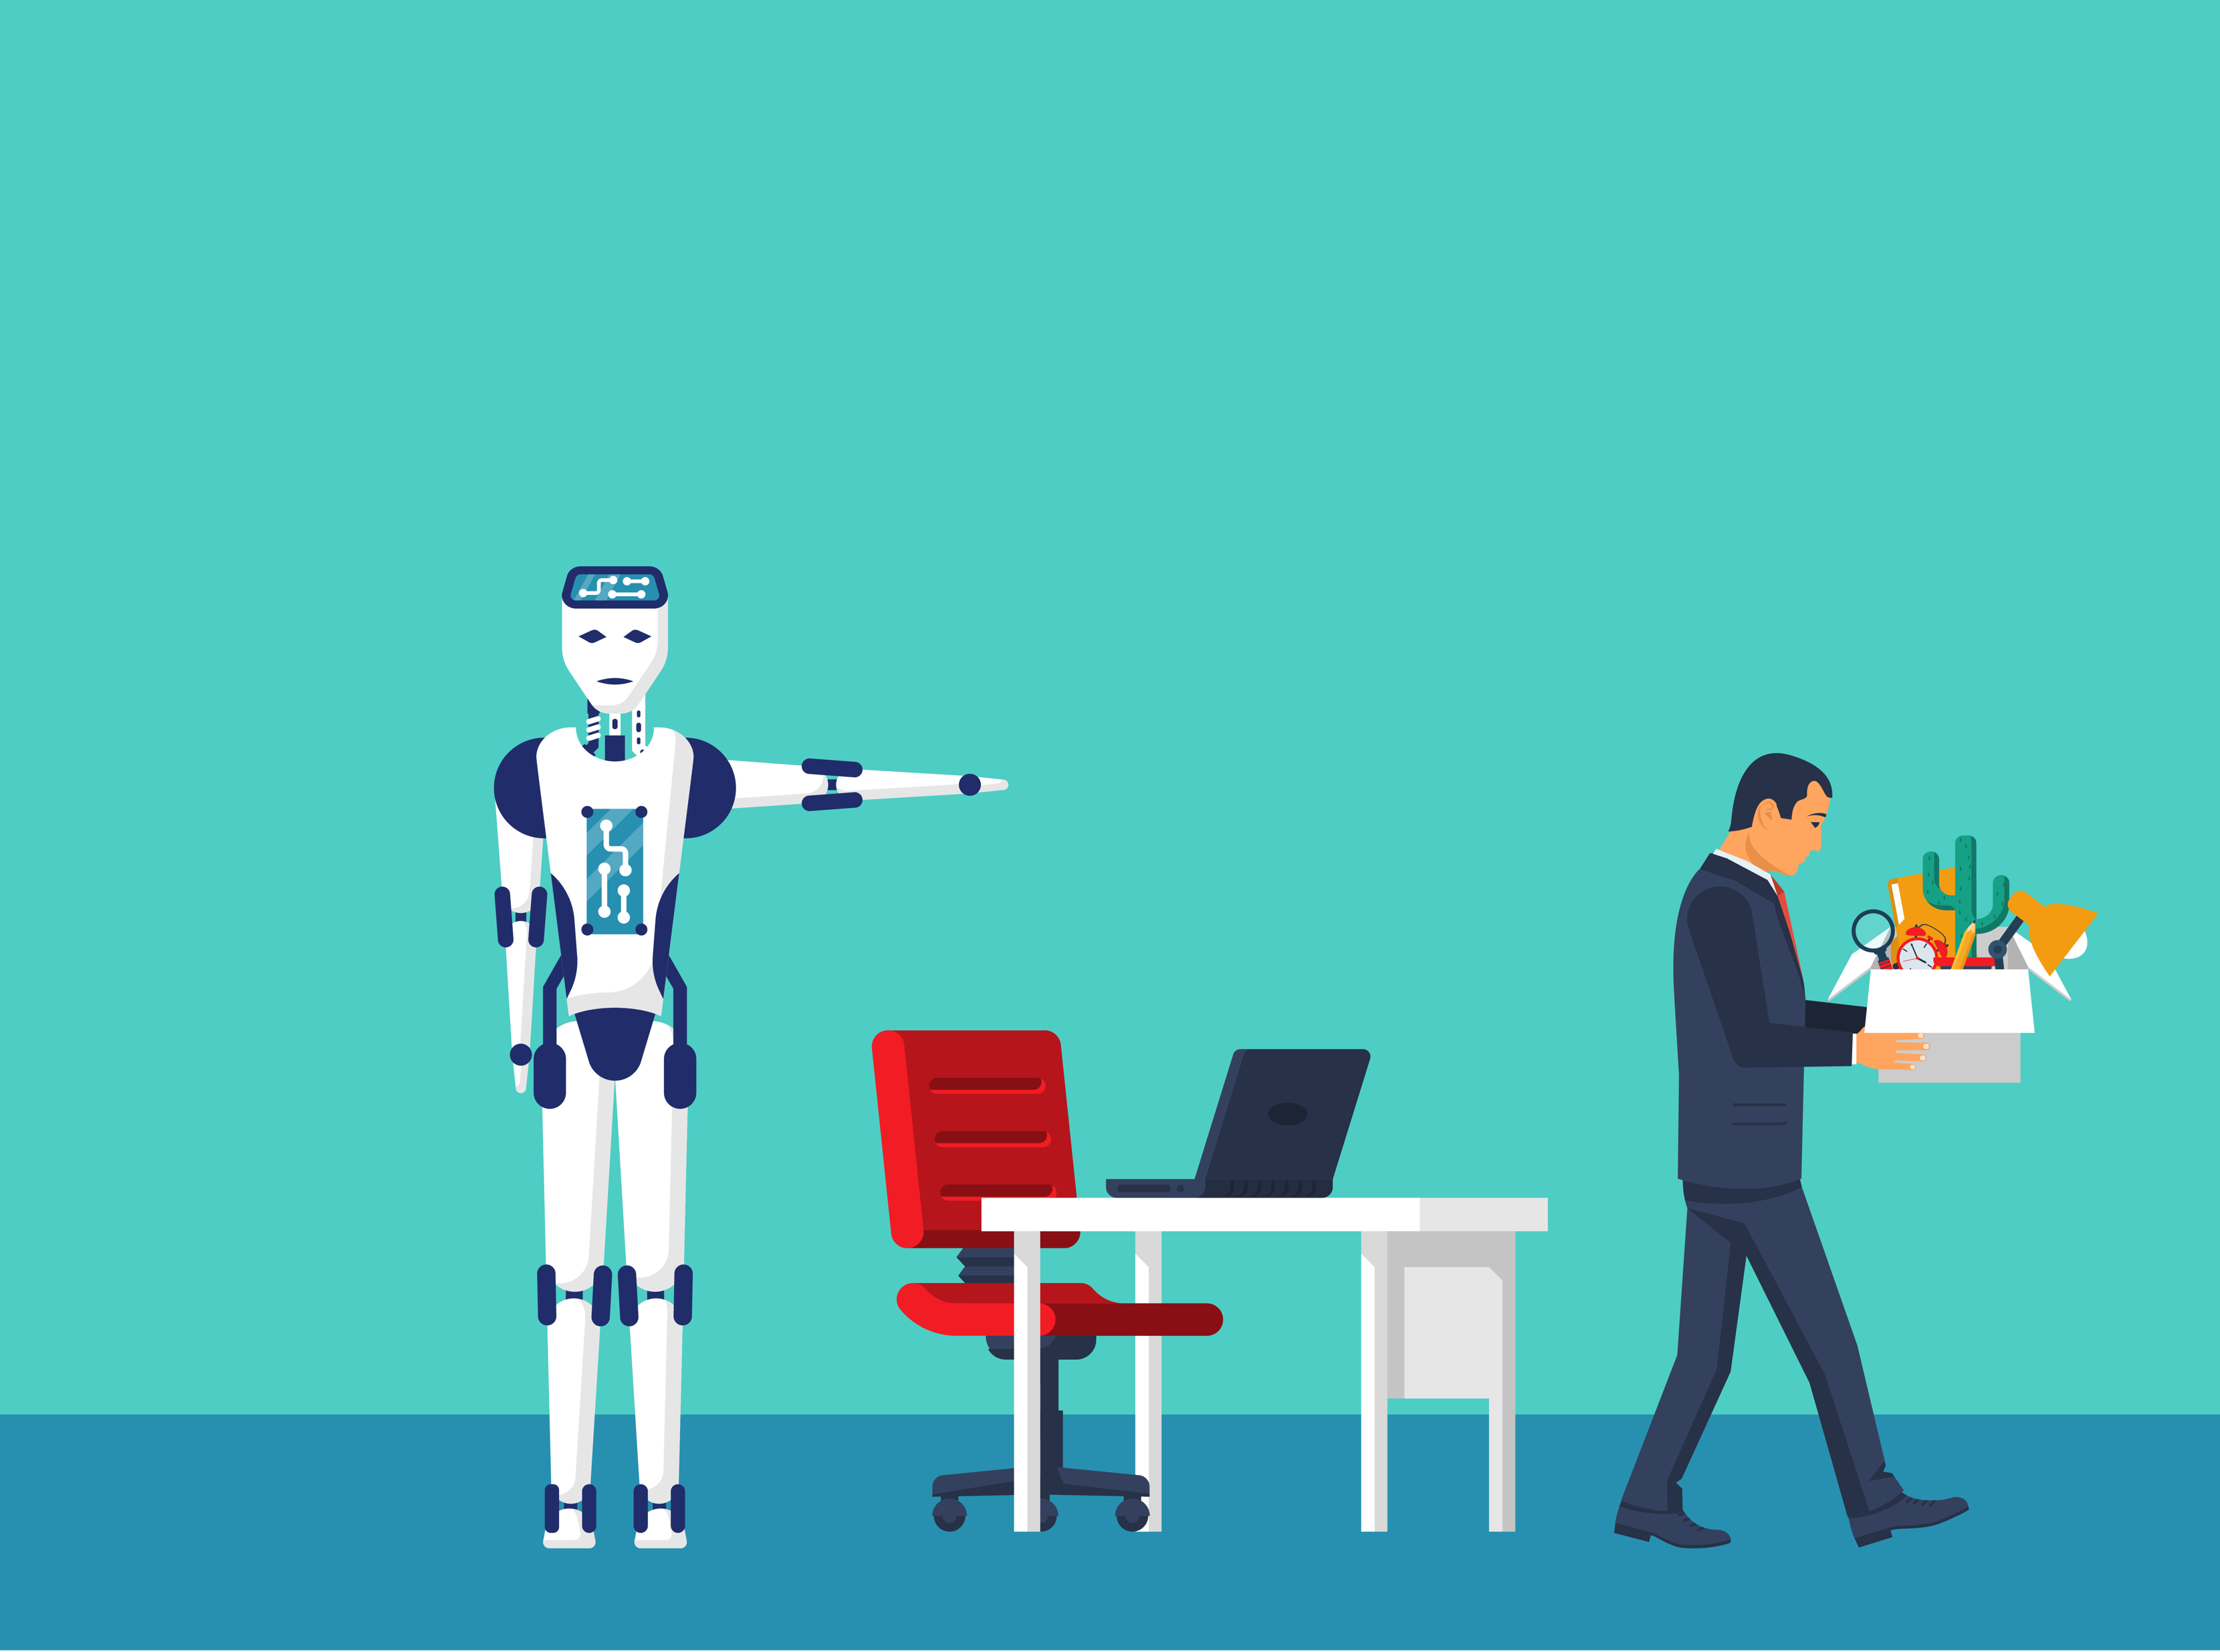

TECHNICAL EXPERTISE
WILL TECHNOLOY
TAKE OVER?...

Slide 12
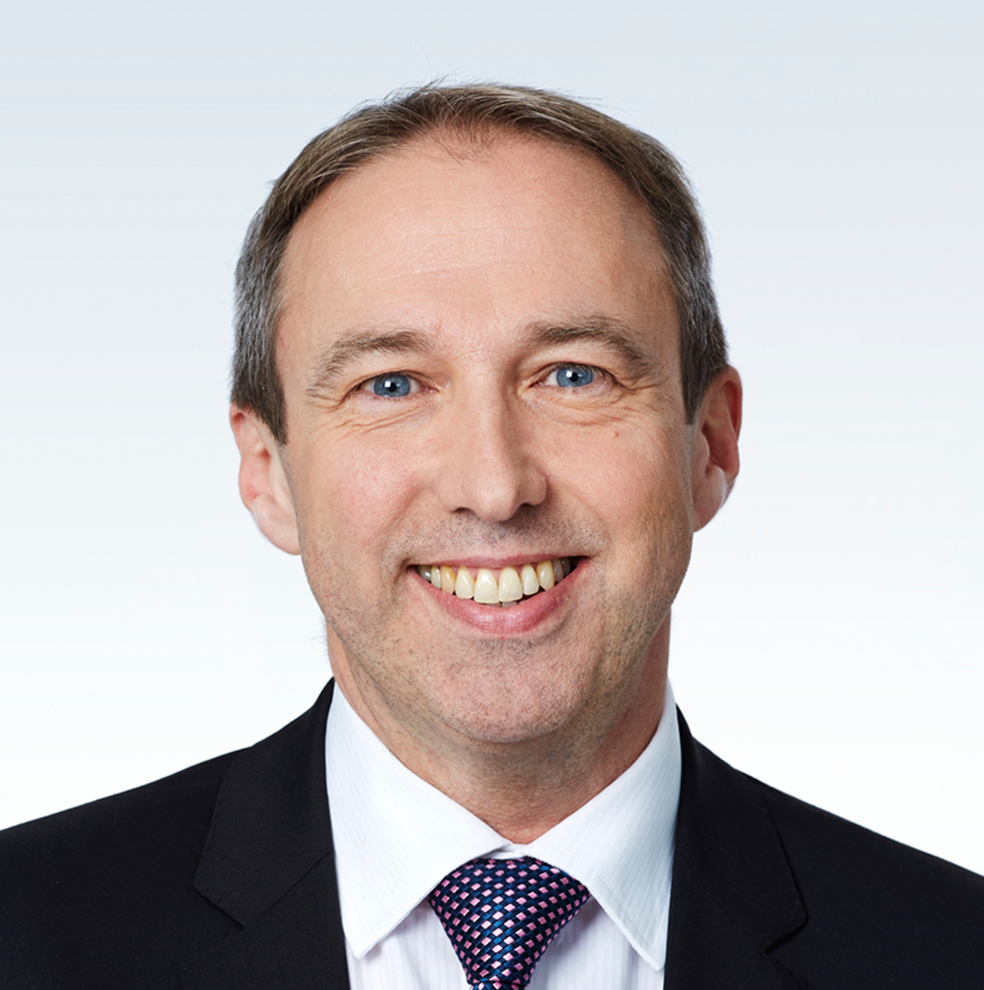
THE EXCITING THING ABOUT
TREASURY IS ITS AFFINITY WITH
TECHNOLOGY AND CLOSENESS TO
DIGITAL DEVELOPMENTS
Jan-Martin Nufer,
Director Treasury and Funding, Borealis Group

Slide 13

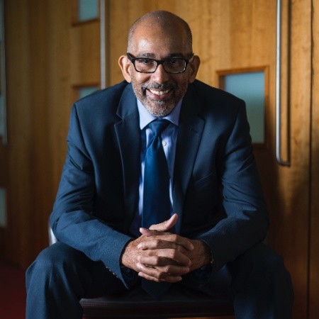
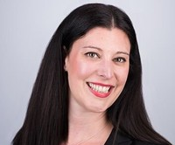
“Technology helps us to manage our workloads so that we can be out in the business doing more on the front line”
KATE MOORCROFT, GROUP TREASURER, BARRATT DEVELOPMENTS
“Technology does not replace people, it replaces processes”
ROYSTON
DA COSTA, ASSISTANT GROUP TREASURER, FERGUSON

Slide 14
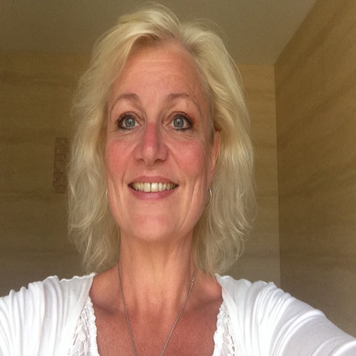
OBVIOUSLY THEY NEED THE
TECHNICAL SKILLS, BUT IT’S ALL
ABOUT ATTITUDE. I CAN GENERALLY
TEACH EVERYTHING ELSE.
Irene Atkins,
Head of Treasury, ASOS

Slide 15

RELATIONSHIP BUILDING
Eddie Trahearn,
Director of Treasury, Belmont Green Finance
FORGET AI, IT’S ACTUAL
FACE-TIME THAT’S IMPORTANT.
IT’S THE HUMAN ELEMENT TO TREASURY
THAT WILL ALWAYS BE NEEDED

Slide 16

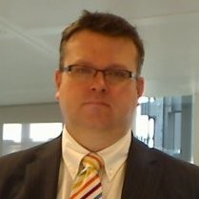
COMMUNICATIONS
Stephen Long,
Group Treasurer, Williams Lea Tag
ALWAYS SPEAK THE PEOPLE’S LANGUAGE

Slide 17
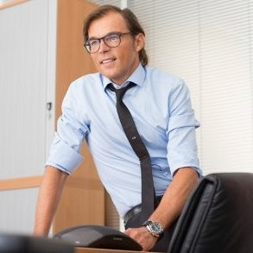
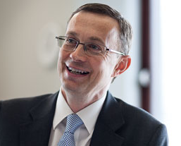
PROPENSITY TO LEARN
“Ability to ask “what does this mean?” – Not just churning out the numbers. Not just using cognitive ability or analytical skills, but curiosity”
IAN CHISHOLM
VP CORPORATE
FINANCE BHP
“How can you claim to be a good treasurer if you’re not looking at what’s going on around you?”
FRANCOIS MASQUELIER, GROUP TREASURER,
RTL GROUP

Slide 18

LinkedIn
Conferences
Talk to colleagues
Find a mentor
‘CURIOSITY’
Join Groups
Podcasts
Read articles

Slide 19

STRATEGIC THINKING
OVER THE PAST
5 YEARS, TIME
INVESTED BY TREASURERS ON STRATEGIC ISSUES HAS RISEN BY OVER
60%
BOARDS ARE
ACCEPTING
TREASURY
RECOMMENDATIONS
MORE THAN
80%
OF THE TIME
87%
OF TREASURERS BELIEVE TREASURY HAS TAKEN A MORE STRATEGIC ROLE

Slide 20
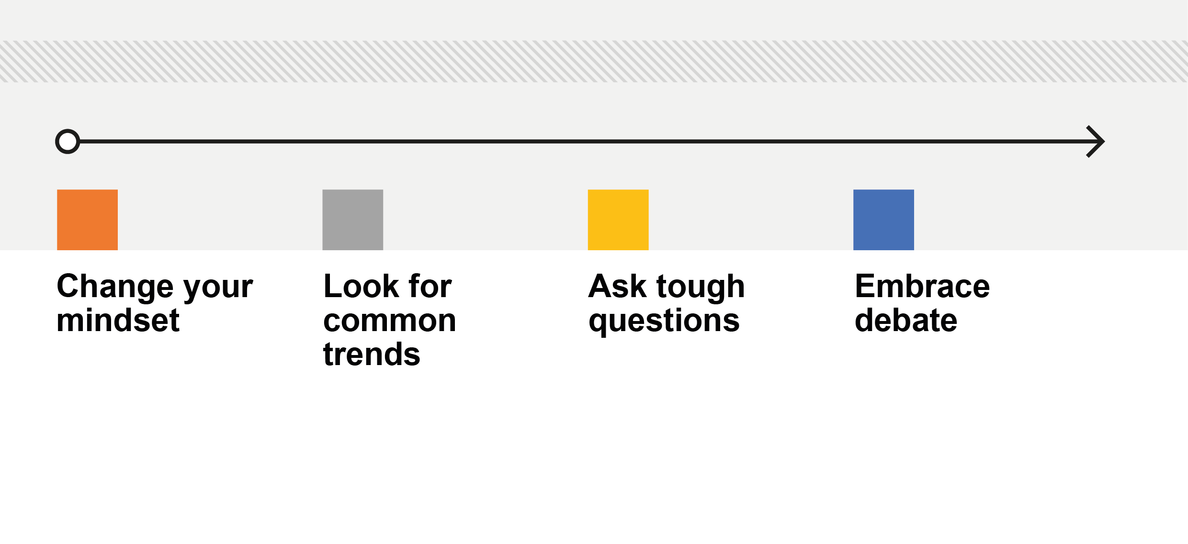
HOW TO BE MORE STRATEGIC

Slide 21

RISK TOLERENCE
Fred Shacknies,
VP & Treasurer, Hilton Worldwide
RISK IS A REALITY IN EVERYTHING
WE DO. EVERY ACTION HAS SOME ELEMENT OF RISK ATTACHED. NOTHING WE DO HAS PERFECT INFORMATION

Slide 22
Step 4:
Investing in a Mentor / Coach
HOW TO TAKE INTELLIGENT RISK
If I do this, what potential outcomes could I expect? What will I gain or lose? What stands in my way? How will I overcome the obstacle?
Review the risk
Assess lessons learned
Have I done this before? What was the outcome? How have others faired? What mistakes were made? What can I learn from this?
Create a plan of action
When is the best time to take the risk? What specifically has to happen for this to succeed?
Decide next steps
Should you take the risk? If so, crack on. Don’t hesitate. Have confidence in your actions.
Evaluate
outcomes
What have I learned from this experience? How could I use this experience to help improve future results?

Slide 23

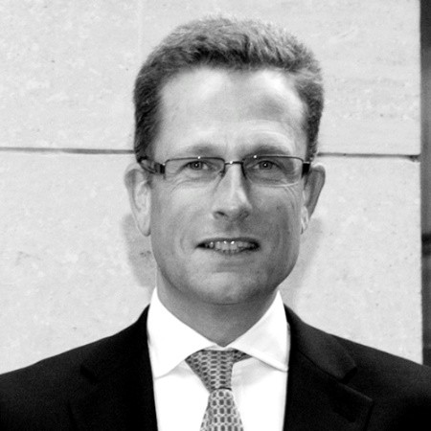
CHANGE RESILIENCE
Nick Taylor,
Head of Group Capital & Treasury Schroders
PACE OF CHANGE IS GETTING FASTER AND FOR TREASURY IT MEANS MOVING WITH THE
CHANGE AND ADAPTING TO IT

Slide 24
Step 4:
HOW TO BE CHANGE RESILIENT
Encouraging
Openness to Change
Accepting
Change
Stop being in control
Show intellectual humility
Eliminate fear
Communicate with transparency
Acknowledge the change
Think positively
Be part of the change
Communicate effectively

Slide 25

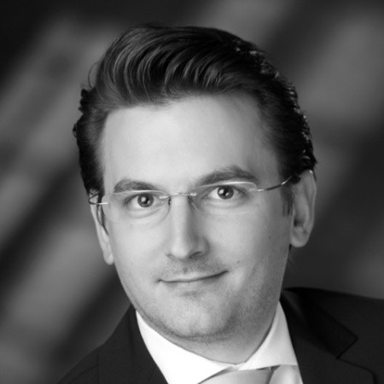
ENTHUSIASM
Felix Warmuth,
Head of Treasury, RGI Magnesita
DO YOU HAVE A PASSION FOR WHAT YOU’RE DOING? IF YOU DON’T, SUCCESS PROBABLY WON’T FOLLOW.

Slide 26
WHY BE ENTHUSIASTIC?
Inspires & motivates
Creates confidence
Gets things done
Sparks new ideas
ENTHUSIASM
Makes things more fun
It’s infectious

Slide 27
HOW TO SHOW ENTHUSIASM
Enthusiasm = openness to carry out tasks that others may be reluctant to do
If you are faced with a problem:
DON’T talk negatively or present negative feelings
DO talk about the problem as the beginning to finding a solution
DO engage everyone involved
DO ask for support in finding a solution
DO lead by example

Slide 28
I BUILT MY CAREER ON TRYING TO SAY “YES” AS MY FIRST INSTINCT TO A QUESTION
Eddie Trahearn,
Director of Treasury, Belmont Green Finance

Slide 29

PERSONAL DRIVE
Eddie Trahearn,
Director of Treasury, Belmont Green Finance
NEVER SHUT THE DOOR – IF SOMEONE’S GIVING YOU AN OPPORTUNITY, GRASP IT WITH BOTH HANDS

Slide 30
HOW TO FIND YOUR DRIVE
Find your WHY
What is my purpose?
Why am I doing this?
Integrate with
your values
What are your key
values? How can you connect these with the work you do?
Change your WHY
Are you doing this task to get it done or to learn something new?

Slide 31
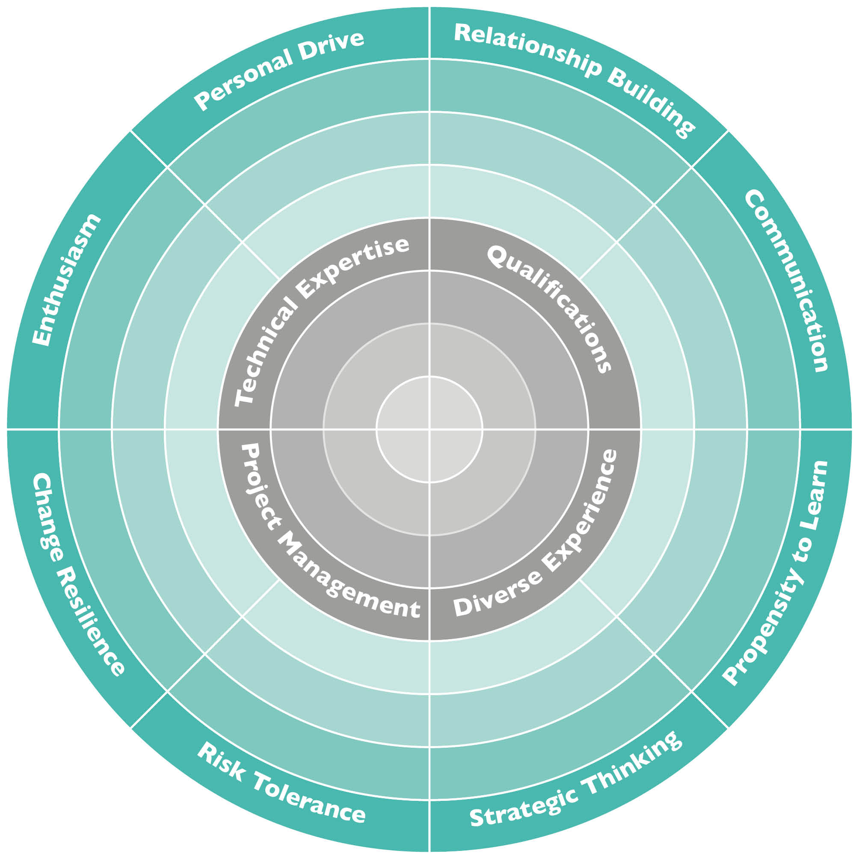
TREASURY SKILLS WHEEL
Downloadable link here…

Slide 32
?
Any questions

Slide 33
FOCUS ON BEING THE BEST POSSIBLE YOU IN EVERY SITUATION
Dana Laidhold,
Treasurer, Peloton Interactive

